Slide 1

Bright Coffee Shop
REVENUE PERFOMANCE ANALYSIS: JAN - JUN
By: Lesiba Sema
Data and Insights Analyst
1

Slide 2
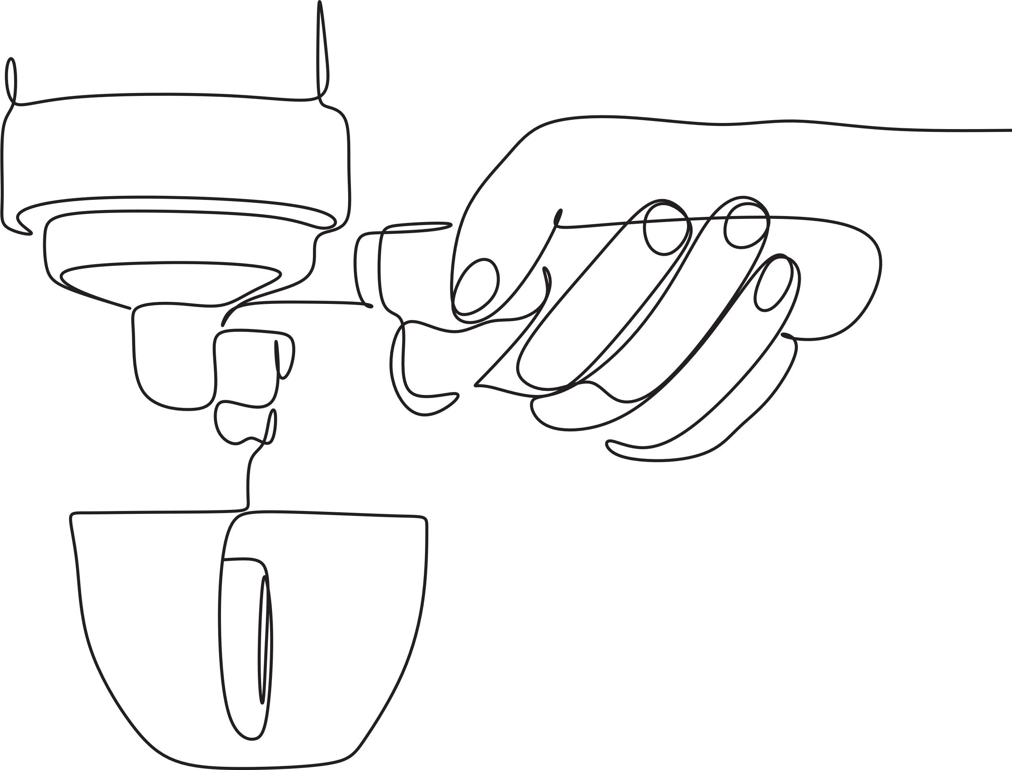
CONTENT
OVERVIEW
ANALYSIS OVERVIEW
BUSINESS OVERVIEW
ANALYSIS: Revenue by store location
ANALYSIS: Revenue by Time Bucket
ANALYSIS: Revenue by Product Category
RECOMMENDATIONS
2

Slide 3

ANALYSIS OVERVIEW
This presentation provides this analysis of the coffee shop’s revenue performance over a defined period. It highlights key revenue streams, customer purchasing patterns, and peak sales periods.
The aim of the diagnostic analysis is to study what influences customer purchasing performance, product-based performance, store location and sales trends to identify key metrics that contribute to the incline or decline of revenue.
The analysis will be used to investigate probable cause to the decline in revenue and highlight key strategic points that the business will need to focus on to drive revenue in a positive incline.
3

Slide 4

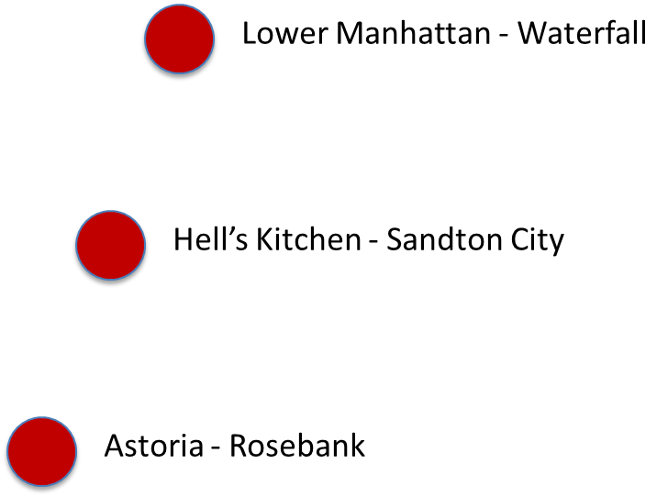
BUSINESS OVERVIEW
Bright coffee shop is a franchise business with 3 stores in prime locations of Johannesburg.
Our stores are located in:
Astoria - Rosebank
Hell’s Kitchen - Sandton City
Lower Manhattan - Waterfall
4

Slide 5

ANALYSIS: Revenue by store location
Hell’s Kitchen was the top-performing store, contributing 33.84% of revenue, followed by Astoria 33.23% and Lower Manhattan 32.92%.
Performance differences are likely due to location—Hell’s Kitchen benefits from high corporate activity and mall access, attracting a wider customer base, while Lower Manhattan serves mainly office park visitors.
Sales increased across all stores from January to June, with an overall growth of about 50%. February was the lowest-performing month, with similar performance across stores, followed by steady growth from March to June.
This trend may be driven by seasonal changes, as colder weather in Johannesburg from March to June increases demand compared to January and February.
5

Slide 6

ANALYSIS: Revenue by Time Bucket
Mid-morning and rush hour sales contributed 55,36% of the total sales from Jan to Jun, Afternoon sales contributed 23,30% of the total sales with evening and night sales contributed 21,34% of the total sales.
This Could be attributed to the colder mornings especially between March and June.
6

Slide 7
ANALYSIS: Revenue by Product Category
Coffee is the leading category, contributing 12.84% of total product performance, followed by Tea at 9.71%, confirming that beverages dominate overall sales volume across all stores.
Hell’s Kitchen slightly leads in high-volume categories like Coffee with just over 30% share by quantity among stores) and Coffee Beans, while Lower Manhattan performs better in Flavors (~3.77% contribution), indicating location-based customer preferences.
Low-performing categories include Branded (0.78%), Packaged Chocolate (0.16%), Loose Tea (0.25%), and Coffee Beans (1.46%), each contributing less than 2%, highlighting opportunities for growth or product optimization.
7

Slide 8

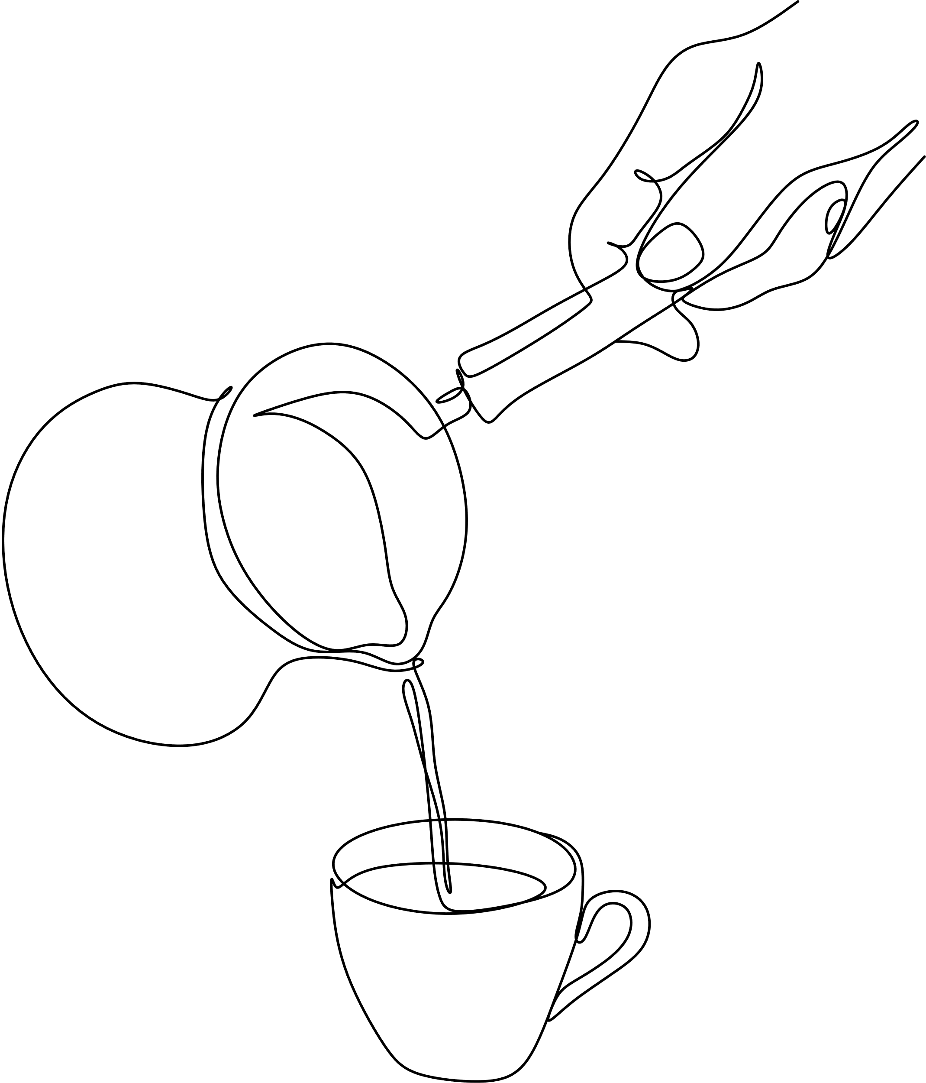


RECOMMENDATIONS
Store Operations
The business should consider introducing a mobile application platform and delivery services, to mitigate waiting times.
Avoid overstocking on low selling products to ensure that there is balance of stock and sales
Implement customer feedback channels and to study purchasing patterns to see what are customers preferred products
Product and Store Promotions
Have daily and weekly specials such as 2 for 1 specials on the beverages (coffees and teas).
Include promotions on multiple purchases (e.g. free muffin for every two coffees/tea bought)
Introduce loyalty programs and incentives for regular customers (such as in-app deals
Run seasonal promotions to promote popular seasonal products (Coffee/tea and muffins/Scones for winter season and Iced Coffee/Tea for summer seasons
8

Slide 9

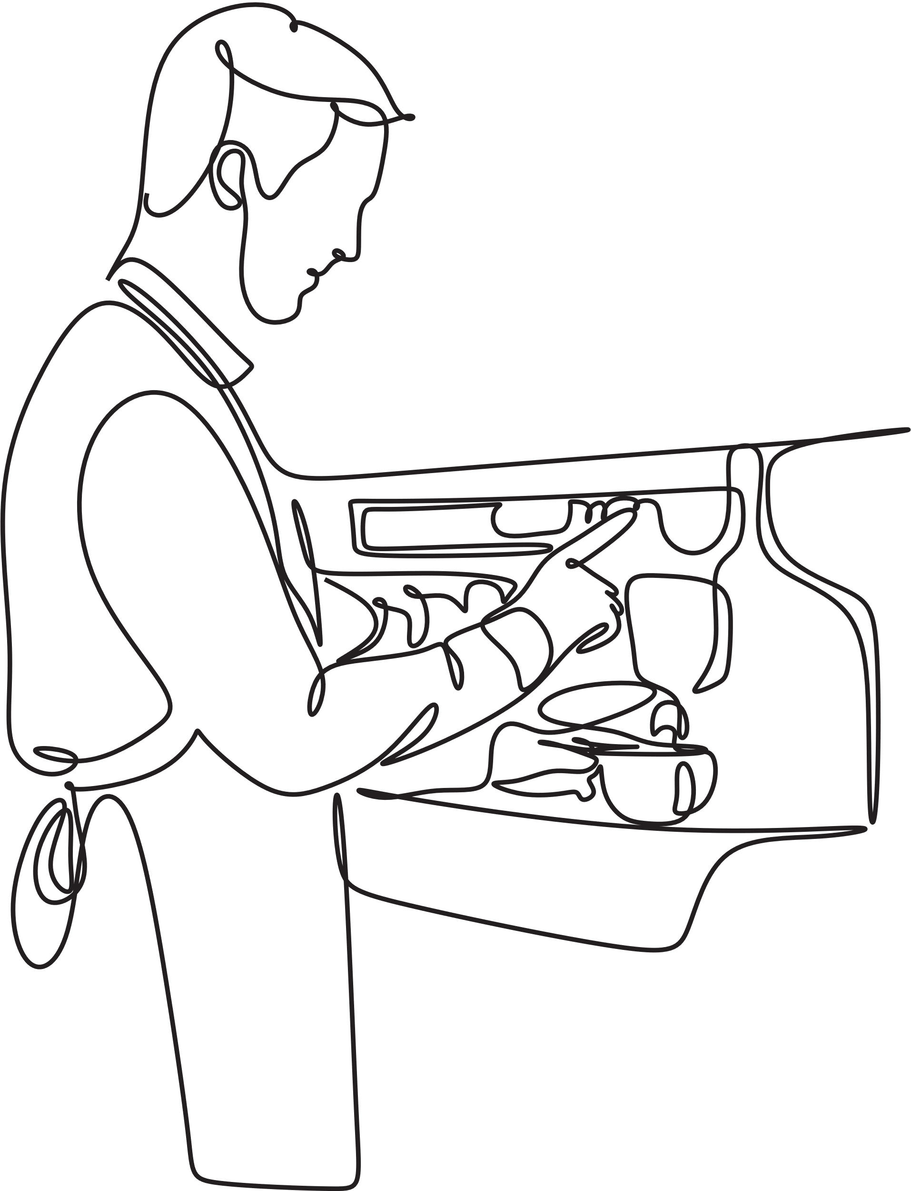
THANK YOU

